Slide 1

SmartSwish AI Project
Oreoluwa Dopemu
2305729
Supervisor: Nasir Ibrahim
A new way to consume NBA and basketball content

Slide 2

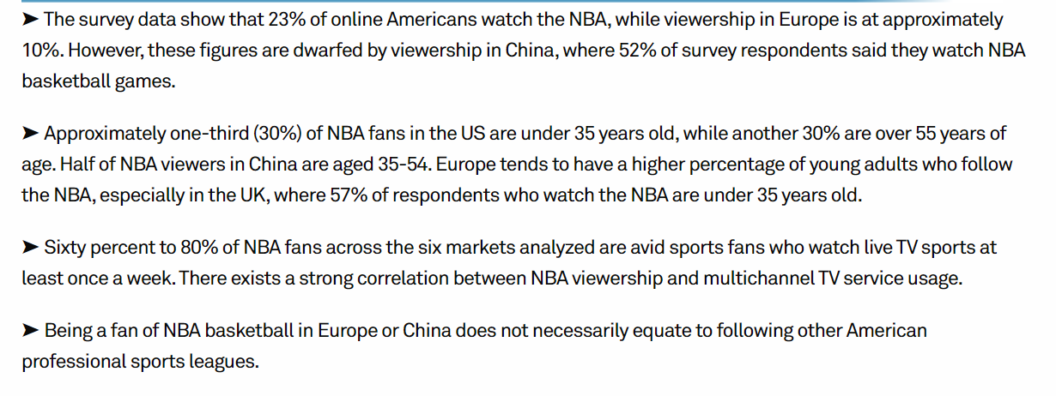

BACKGROUND INFO
Problem:
NBA games are lengthy, and time zones make live viewing difficult.
Global coverage is often insufficient, reducing fan engagement.
Solution Overview:
Development of an AI tool to create quick, automated NBA game highlights.

Slide 3
Justification for the Project
Time Efficiency: Saves viewers and analysts considerable time by providing condensed games.
Enhanced Engagement: Increases global fan interaction with the NBA.
Technological Innovation: Leverages AI to provide new ways to consume sports content.

Slide 4
AI Analysis
Condensing NBA games into highlights
Pros
Cons
Allows a quick way of watching NBA footage
Captures the essence and nature of an NBA game without watching the full game
Saves human time of compiling highlights manually
Removes possibility of fan bias from highlights
Requires potentially extremely complex algorithms
Needs long stretches of footage in order to be interpreted
Could take a lot of space to compile and concatenate

Slide 5
Ethical Considerations
Data Privacy:
Video analysis involves players, referees, and fans.
Ensuring proper data handling is crucial to prevent misuse.
Algorithmic Bias:
Imbalance in training data may lead to biased highlights.
Mitigation: Aim for diverse and balanced datasets.

Slide 6
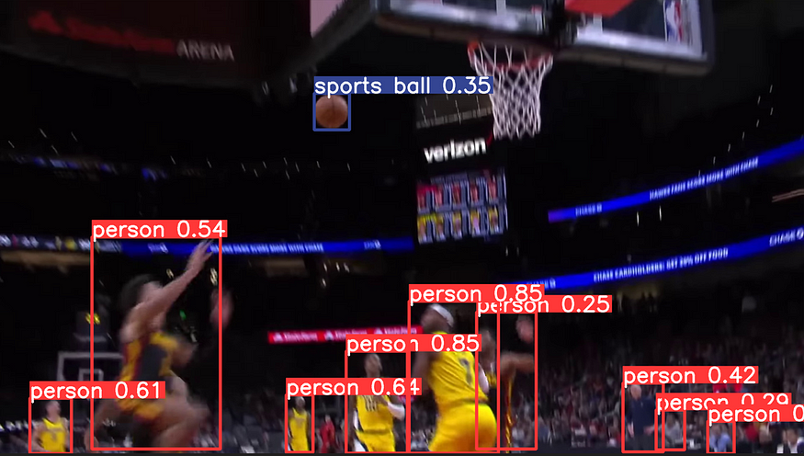
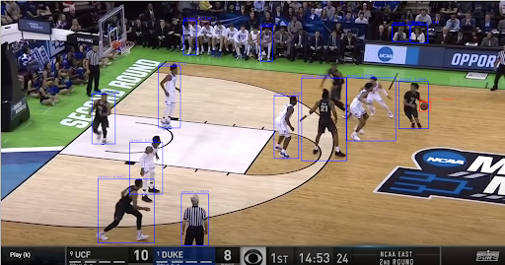
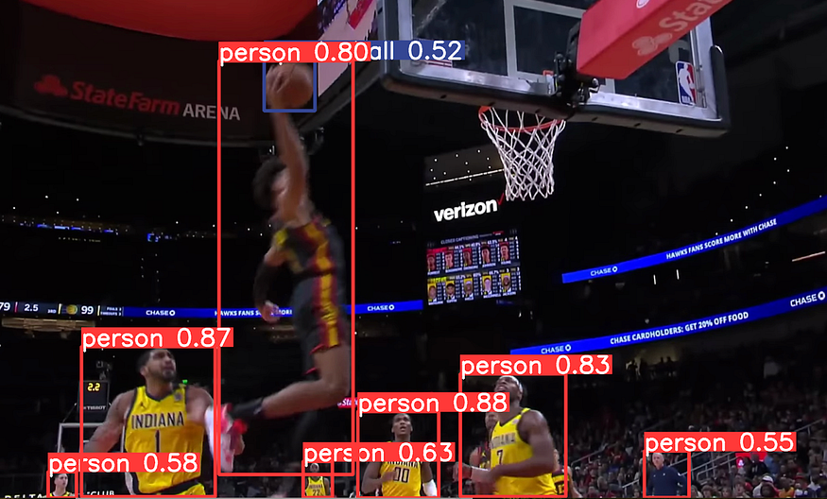
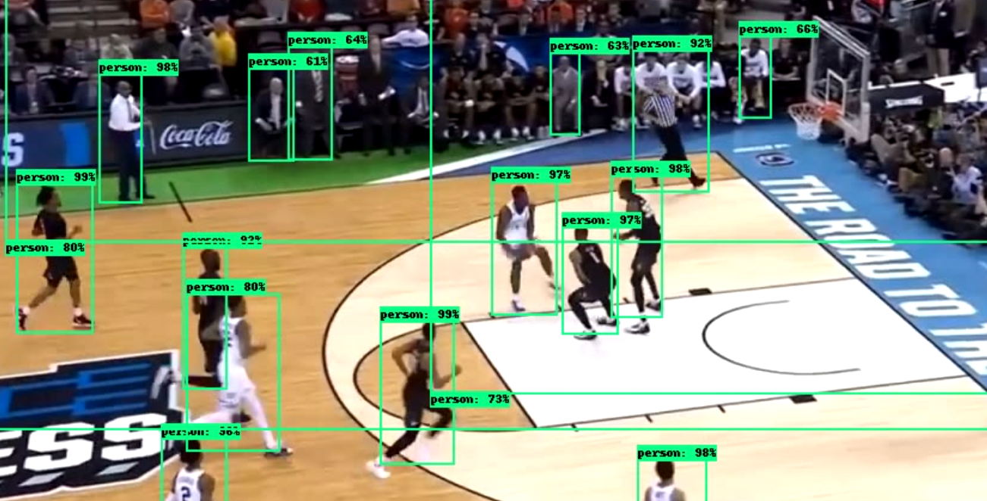
Approach and Methodology
Video Techniques
AI Model Used: Implementation of YOLO (You Only Look Once) for object detection.
Data Labeling Process:
Annotated frames using labelImg for training.
Focused on detecting made baskets, basketballs, blocks, steals, etc.
Time constraint of acquiring knowledge of object tracking
Difficulty and complexity of algorithms
Requires heavy CPU usage
Takes time to run algorithm for all frames
Training an AI model takes extensive time

Slide 7
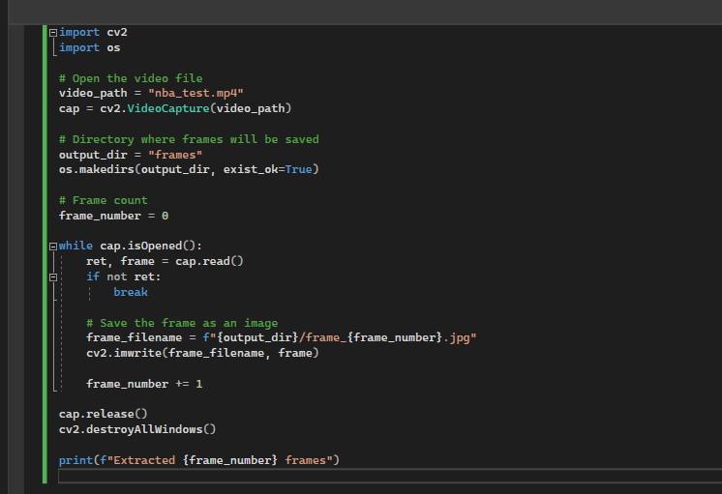
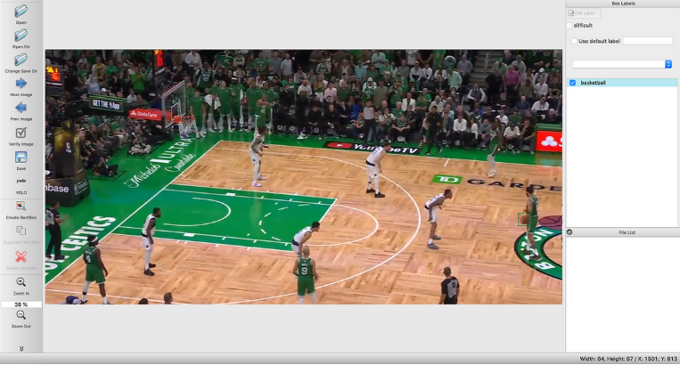
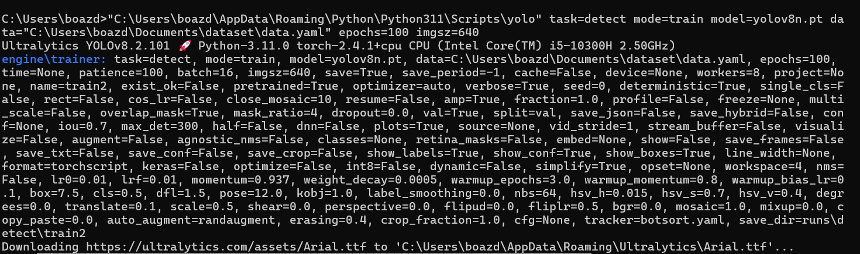
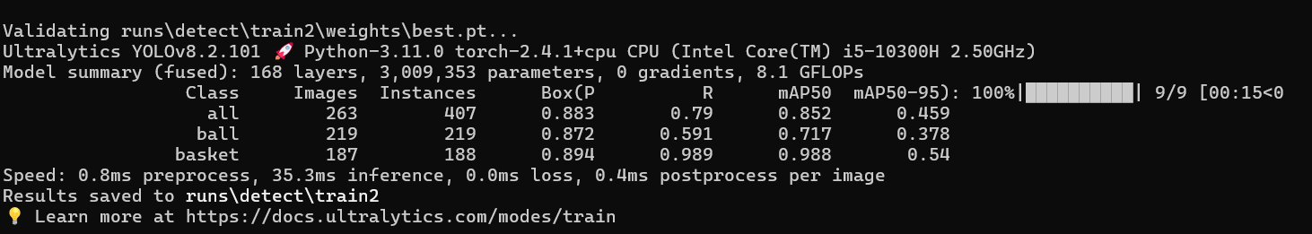
Implementation Challenges & Solutions
Challenges:
Difficulty in recognising basketballs under different lighting conditions.
Complex and time-consuming frame-by-frame labeling.
Solutions:
Enhanced model with new labelled datasets.
Prioritised key events to reduce computational demands.

Slide 8
Training the Model
Training Setup:
Configuration File (YAML):
Specified paths to training, validation, and test datasets.
Defined parameters such as batch size, number of epochs, and model architecture.
Data Split:
Training Data (70%): Used to train the model to learn patterns and detect key events.
Validation Data (15%): Evaluated during training to tune hyperparameters and prevent overfitting.
Test Data (15%): Set aside for final evaluation to determine the model’s performance on unseen data.
Training Process:
Used GPU acceleration to train the model efficiently.
Ran multiple epochs to minimize the loss function, adjusting learning rates based on initial performance.
Evaluation Metrics:
Mean Average Precision (map): Measured the accuracy of object detection, specifically made baskets and key events.
Loss Metrics: Monitored classification and localization losses during training.
Validation Results:
map Score provided insights into the model’s precision and recall, indicating how well it could identify critical moments.
Iterative Improvements:
Fine-tuned model based on validation and test results to optimise highlight selection.
Notes:
mAP takes into account both precision (how many detected objects are correct) and recall (how many relevant objects were detected), giving a balanced measure of model performance.

Slide 9
Future Work
Tool Enhancement:
Improve detection of key plays like blocks, steals, and dunks.
Web Platform Development:
Develop user-friendly interface for uploading and downloading clips. Make the website look far more user friendly
API Integration:
Explore connecting to more live NBA data through APIs, ever-growing possibilities
Platform Limitations:
CPU struggled to cope with tasks (training)

Slide 10
THANK YOU
Any Questions?
Notes:
Why did you choose YOLO for object detection? YOLO is known for its speed and accuracy in real-time object detection tasks. It can efficiently detect objects in each frame of a video, which is crucial for this application that involves analyzing basketball games.
How does the video processing pipeline work? The uploaded video is analyzed frame by frame using the YOLO models. First, the video is processed for all objects, and then a specific model detects made baskets. These key moments are extracted and stitched together to form the highlight video.
How are the API routes implemented? The API routes fetch data (like league standings or leaders) from the NBA Stats API using the requests library. Parameters such as the season and stat category are passed in the URL, and the response is processed and returned as JSON to the frontend.
What happens when an error occurs during video processing? If any error occurs, the try-except block catches it, prints the error message to the console, and returns a JSON response with the error to the client, ensuring graceful failure.

